Slide 1
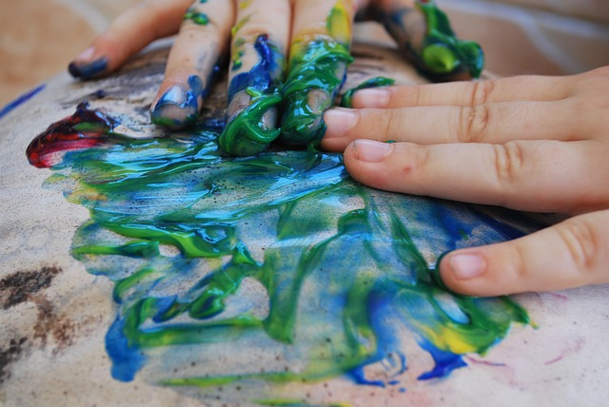
Mark Making in the Early Years

Slide 2
Mark Making
Within the context of an active play-based learning environment, children will have many different ways of representing their thoughts and feelings in the early years. Some will choose music, dance or song, others will prefer to tell stories through role-play, drama or using small world resources, but most will at some point be naturally drawn to represent their ideas graphically. When children realise that marks can be used symbolically to carry meaning, in much the same way as the spoken word, they begin to use marks as tools to make their thinking visible.

Slide 3
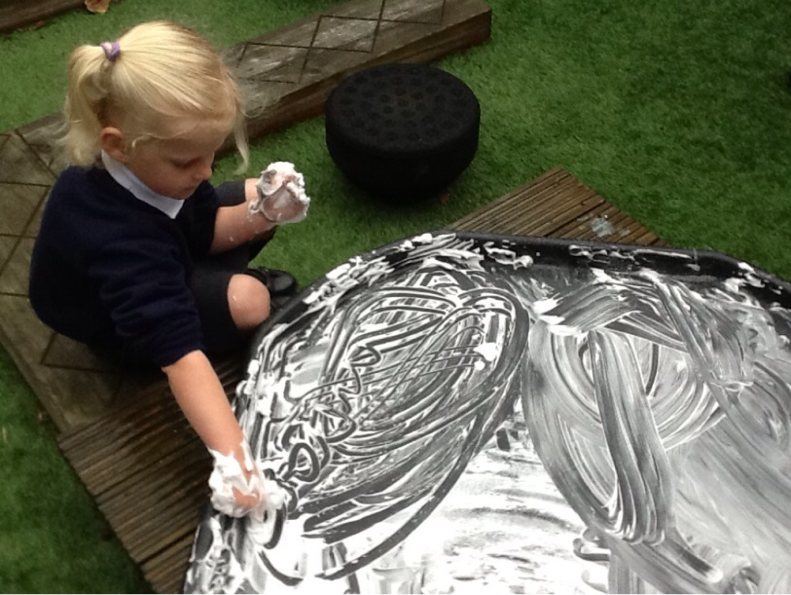
Mark Making without the purpose of an end product
When children first begin making marks they are sometimes made for the pure physical enjoyment of the activity. On these occasions children have no interest in an end product at all; the physical activity is an end in itself and an opportunity for them to experiment and explore with their senses, developing confidence and dexterity through the process.
Notes:
the feel of the felt-tip pen as it glides over the surface of the whiteboard or the chalk as it grates over the bumpy tarmac, the sight of the brightly-coloured dribbles of paint as they run down the paper on the easel, or the sensation of the glue, oozing between children’s fingers as they spread it over the paper. On these occasions children have no interest in an end product at all; the physical activity is an end in itself and an opportunity for them to experiment and explore with their senses, developing confidence and dexterity through the process.

Slide 4
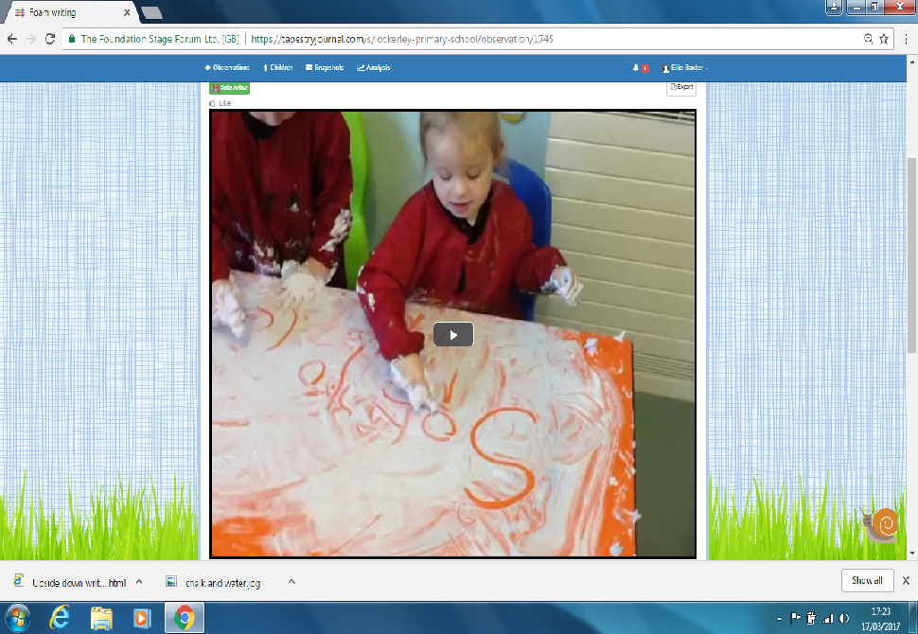
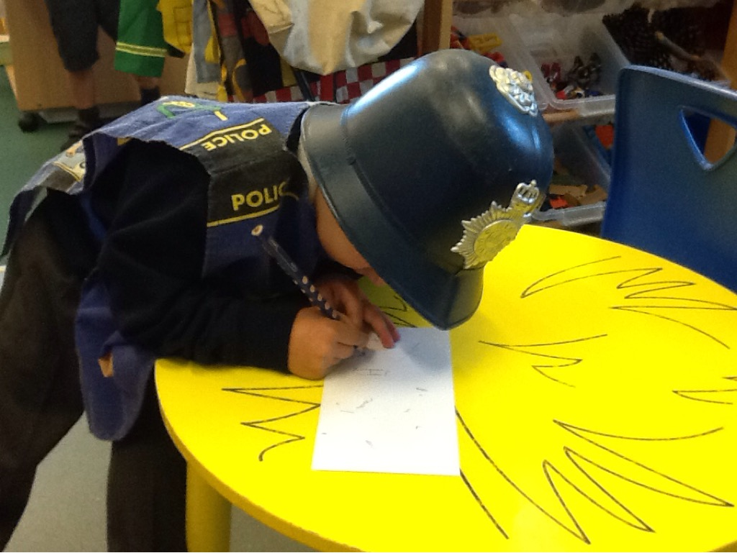
Mark Making with Purpose
At other times and as children develop their interest and skill in mark making they begin to want to give meaning to their marks to inform, tell stories and make observations.
Notes:
Following on from mark making without an end product, chn begin to think about a purpose for their writing and realise they can produce something with meaning that makes sense to themselves and others.

Slide 5
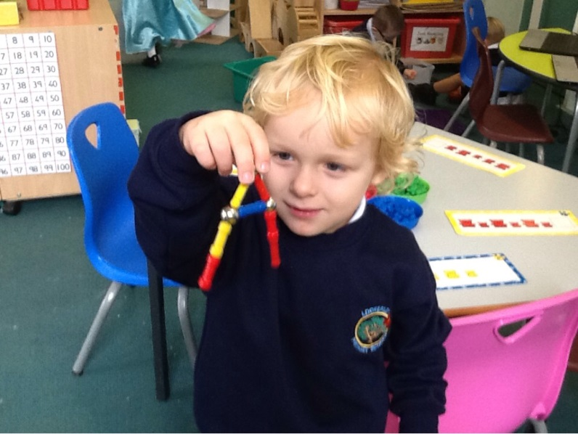
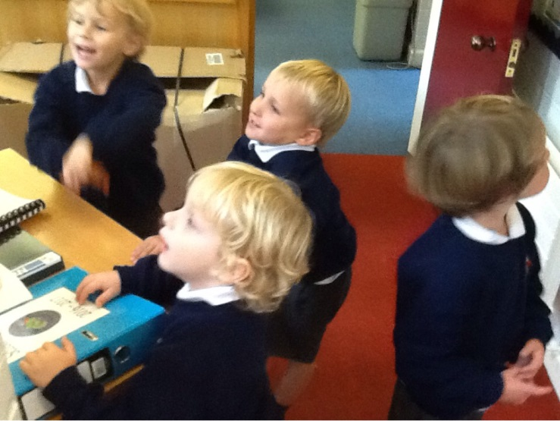
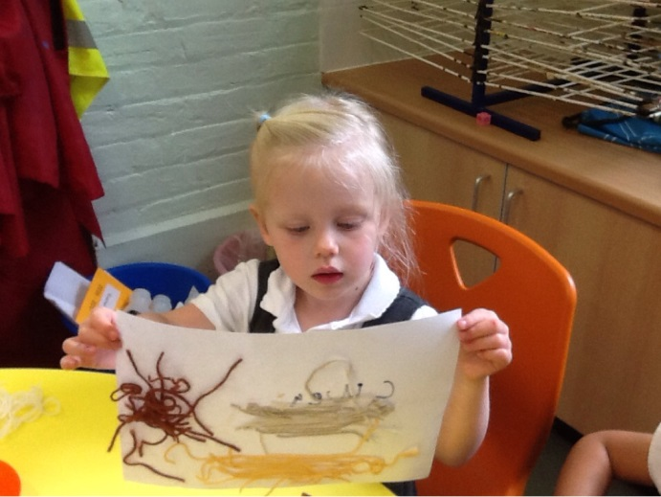
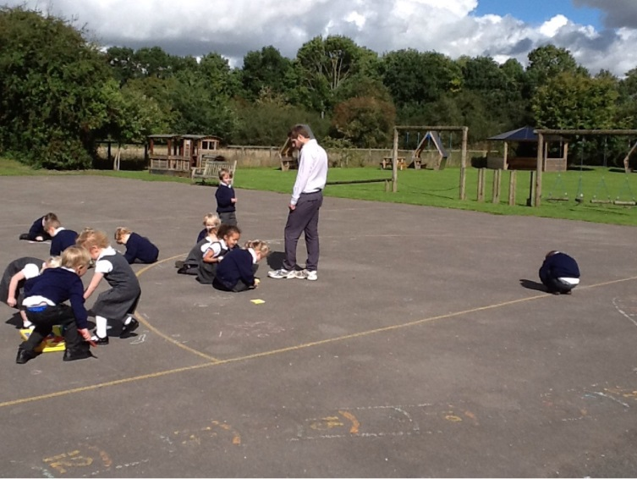
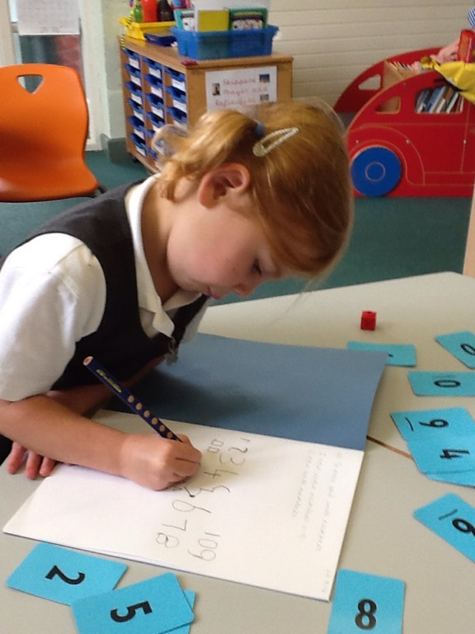
Making sense of the world
Notes:
Alternatively, they might discover that they can use marks to help them to make sense of their world, to solve problems or discover solutions to their lines of enquiry. Children’s fascination with numbers, especially large numbers or those that are particularly meaningful to them, or representations of shape and space, can often be observed in this context.
Number hunt
Millie – trampoline, swing and climbing frame

Slide 6
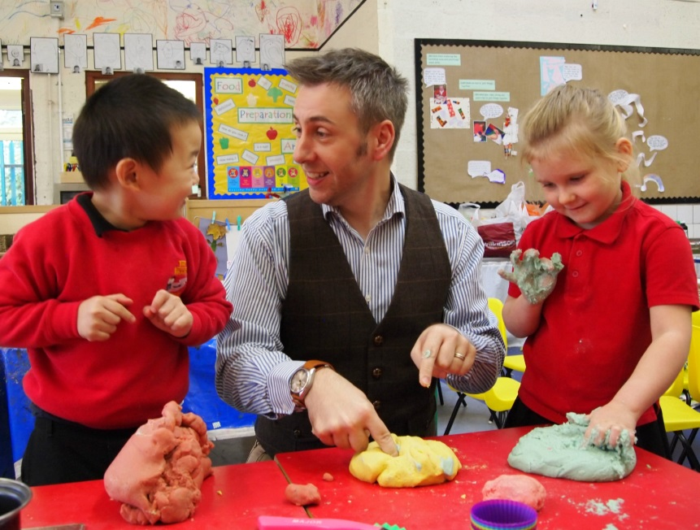
Dough Gym
A single drawing may help a child to develop concepts relating to problem solving, reasoning and numeracy or knowledge and understanding of the world, as well as improving their physical coordination.
Dough gym was developed by Alistair Bryce-Clegg to develop children’s motor ability and help strengthen their fingers as they get ready to write. https://www.youtube.com/watch?v=htzhoKbGbBc
Notes:
Developed by ABC to develop children’s motor ability and strengthen their fingers to get ready to write.

Slide 7
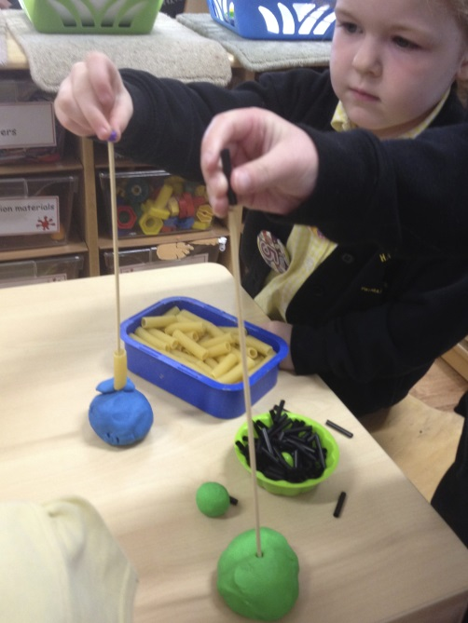
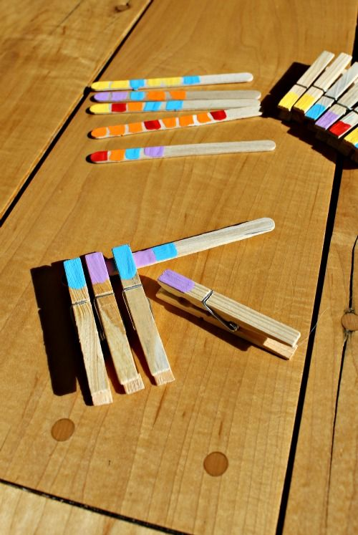
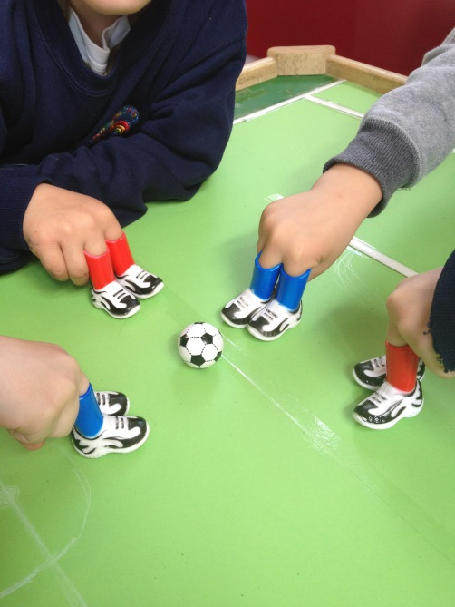
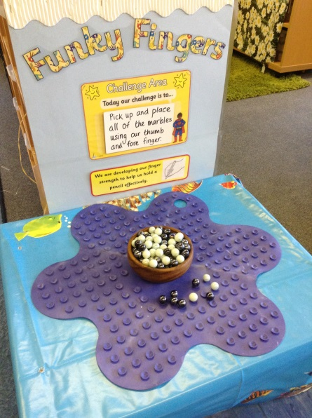
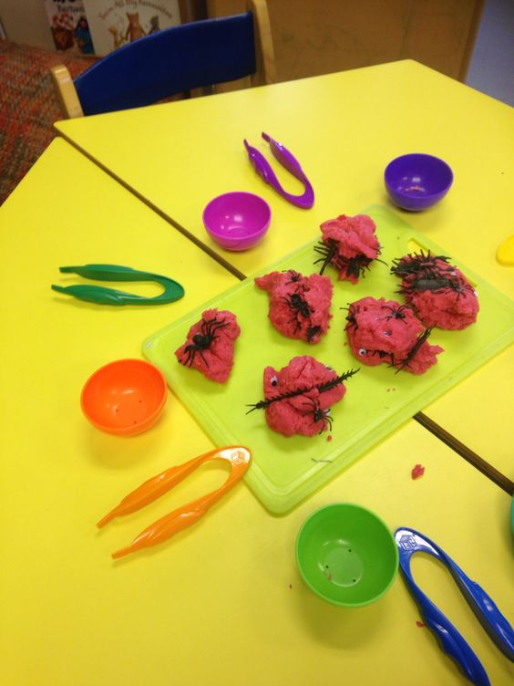
Funky Fingers
Notes:
Develop strength in their index finger and thumb to be able to comfortably hold a pencil.

Slide 8
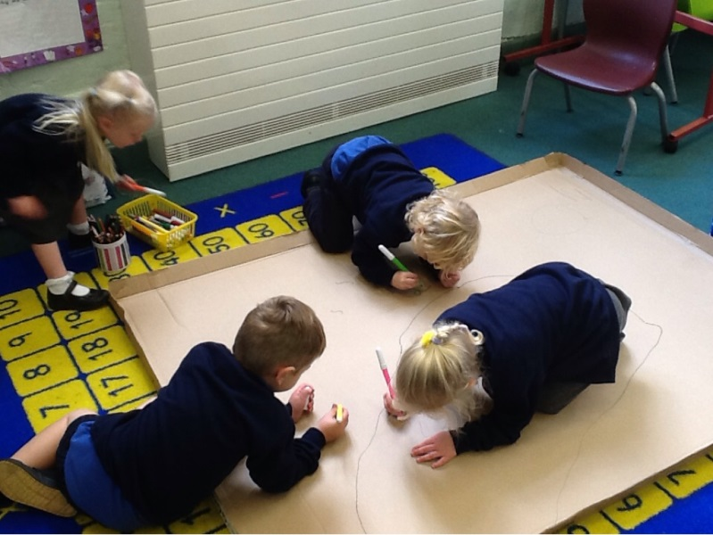
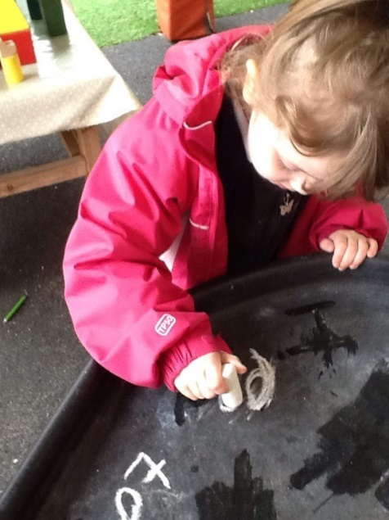
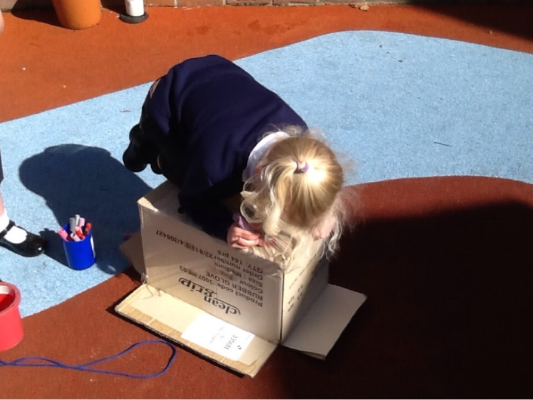
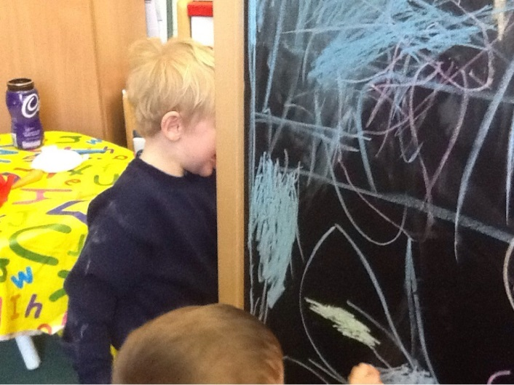
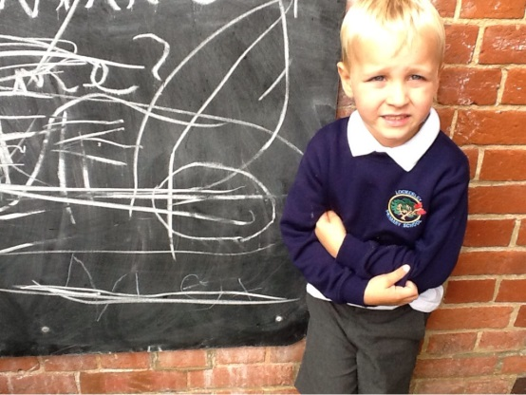
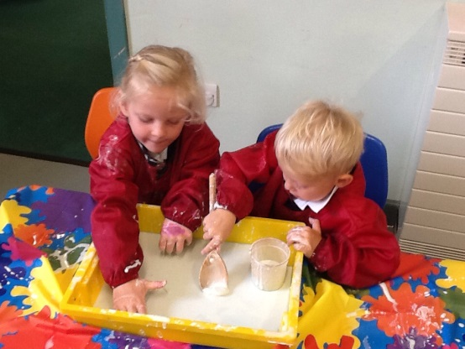
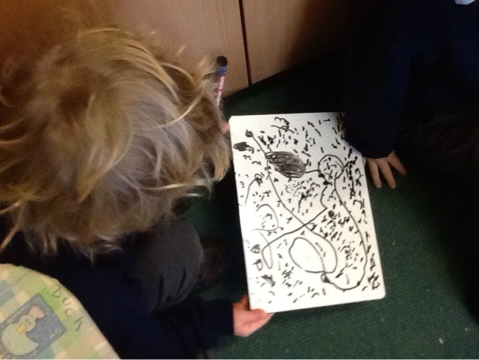
Mark Making in Skippers
It is vital that each child in Skippers has access to a variety of resources to mark make in every area of the classroom both inside and out.
Notes:
Different number of resources to use to make marks with – both with purpose or without

Slide 9
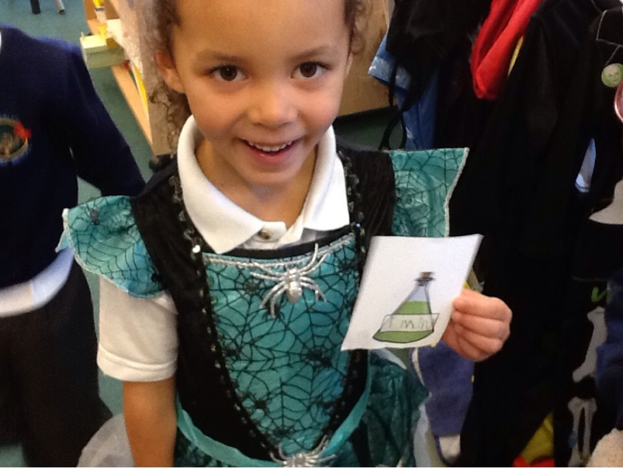
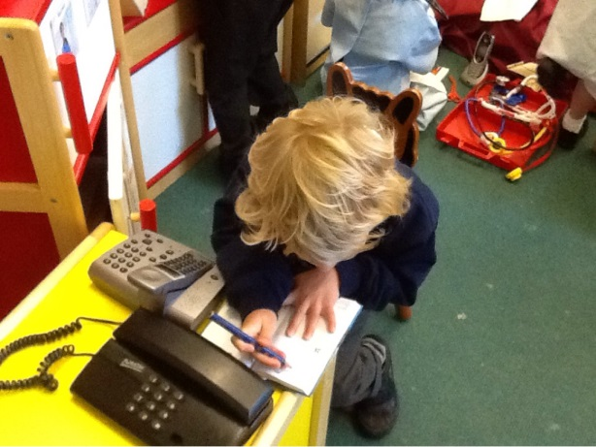
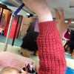
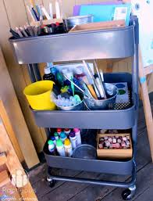
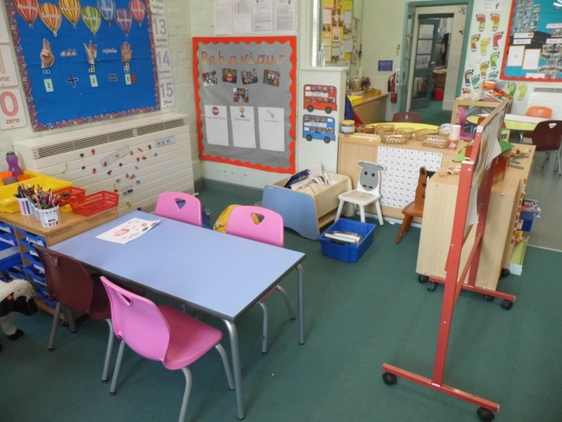
Mark Making in Skippers
Notes:
Access in all areas of the classroom. Develop their sense of purpose such as junk modelling and lego plans.

Slide 10
What can you do at home?
Continue to ensure children have access to a variety of resources to make marks.
Ask children what they are doing to develop their sense of mark making with a purpose. I.e shopping lists, copying, letter writing, card writing.

