Slide 1

SATs Week 2022

Slide 2
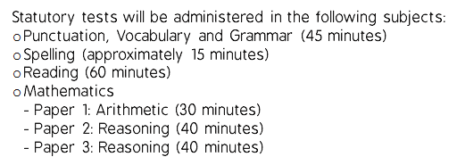
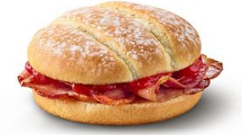
SATs Week 9th May – 12th May 2022
We welcome all Year 6’s to come and have breakfast every day of SATs week
Friday funday!

Slide 3
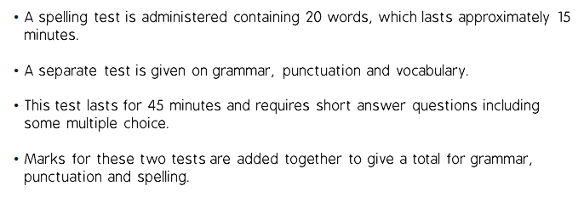
Grammar, Spelling and Punctuation (SPaG/PaGS/GaSP/PSaG/GSaP)

Slide 4
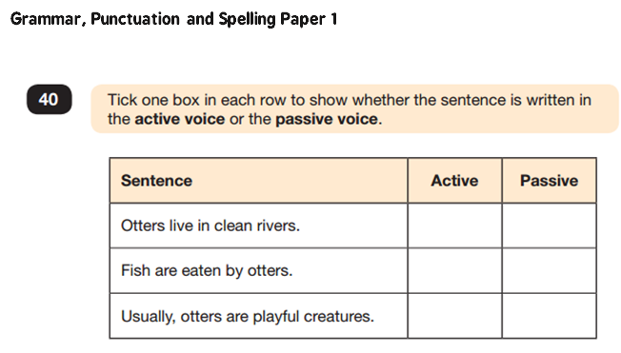

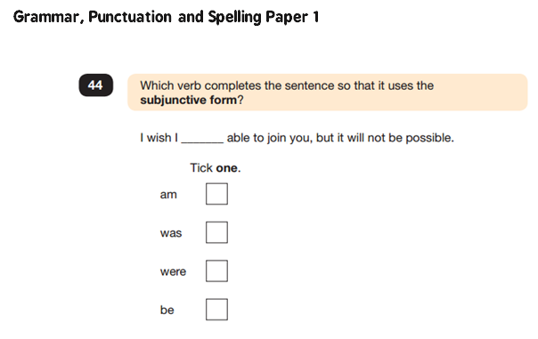

Slide 5
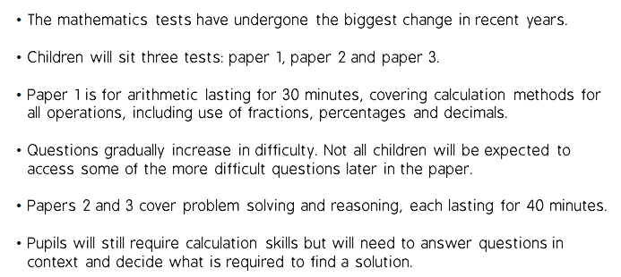
Mathematics

Slide 6
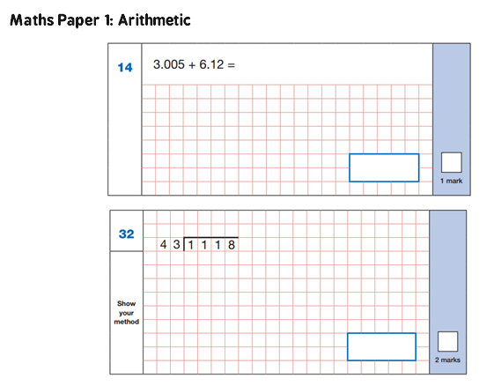

Slide 7
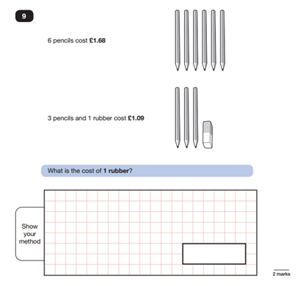
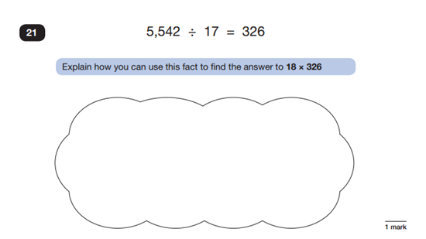

Slide 8
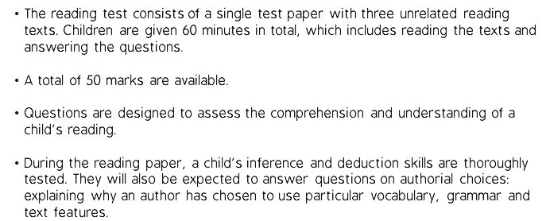
Reading

Slide 9
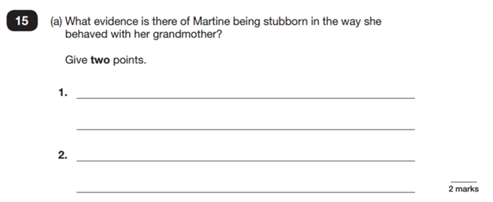
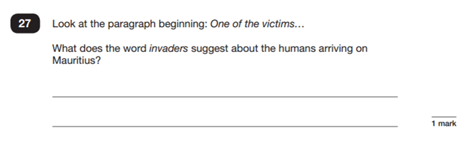

Slide 10
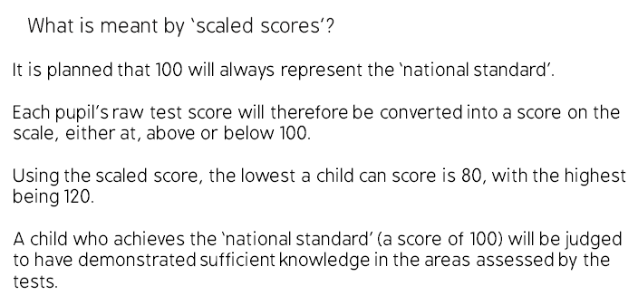
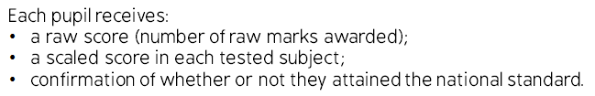

Slide 11
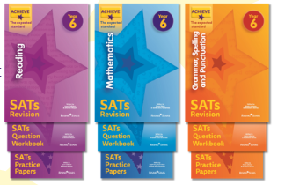
How you can help your child…
First and foremost, support and reassure your child that there is nothing to worry about and they should always just try their best!
Ensure your child has the best possible attendance at school
Hear your child read aloud and ask them questions about what they have read
Practise spellings and times tables

Slide 12
Rising Stars
Please support your child in completing their Rising Stars books. These are not compulsory, but will really help your child with their understanding and confidence.
There are 3 books – Reading, Maths and SPaG
The mark scheme for each of the books is in the back – if your child has made errors, please discuss these with them. This is as helpful as your child getting the questions correct in the first place.
Please ensure these books are brought to school every day – we will be using them in some lessons.
We recommend completing at least a
double page per book per week, if this is
manageable and doesn’t increase
stress levels!

