Slide 1

Lockerley Primary School
‘Believe Together, Achieve Together’
Swallowtails Parent Meeting
September 2025

Slide 2

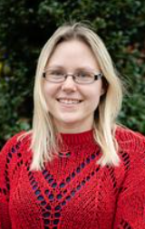
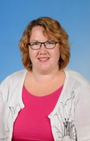
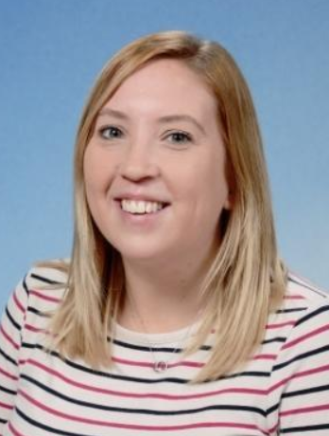
Welcome
Who is who?
Class Teachers:
Miss Lilly and Mrs Clark
Learning Support Assistant:
Mrs Webb

Slide 3
A typical day in Swallowtails…
8.45 – 9.15 | 9.15 – 9.30 | 9.30 – 10.20 | 10.40 – 11.10 | 11.10 – 12.00 | 13.00 – 13.30 | 13.30 – 15.00 | 15.00 – 15.15
Collective Worship | Fluency | Maths | Guided Reading | English | SPaG Spelling, Punctuation and Grammar | Foundation Subjects History Geography Art PSHE Science PE (x2) French Computing DT Music | Class Novel
Tuesday morning – RE with Mrs Bowman

Slide 4
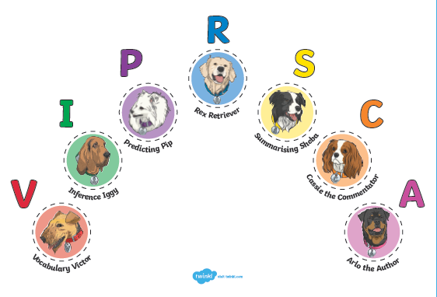

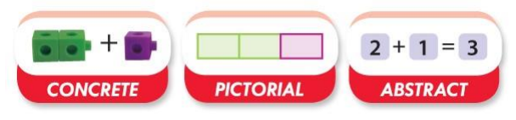
Core Curriculum
Reading
Writing
Maths

Slide 5




Our Curriculum
Autumn
What did our ancestors do for us?
History - Stone Age, Bronze Age and Iron Age
DT - Food – Iron Age griddle cakes
Art – painted Bronze Age setting
Science - Rocks and Light

Slide 6




Our Curriculum
Spring
How and why are places connected?
Geography - Biomes and different climates
History – Romans
DT – Textiles – Roman epaulettes
RE – Good Friday / Easter story

Slide 7



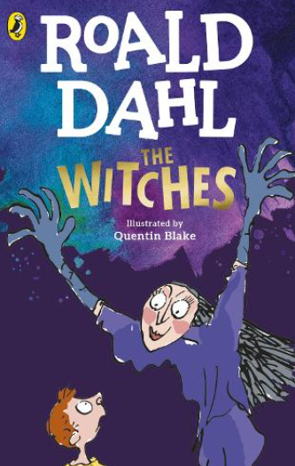
Our Curriculum
Summer
Why are beliefs important?
Geography - African Economic Development
Art – Sculpture
Science – Plants
Music – Key Stage 2 Production

Slide 8
How can I support my child?
How you can help:
Encourage independence!
Support them in showing resilience if they are finding something difficult
Hear them read / read to them as often as you can (4+ times a week), and ask them about what they have read – please sign their reading records
Encourage them to read a wide range of books (Book Bingo can help)
Support them with accessing TTRS at home
Support them with learning weekly spellings

Slide 9

Year 4 Multiplication
Table Check
Don’t panic!
Year 4 MTC assessments take place in May/June.
Before this, you can support your child in learning their multiplication tables.

Slide 10
Information
Children need:
water bottle, reading book, reading record
P.E. - Tuesday and Thursday / Outdoor Learning – Friday
Children need PE kit / Outdoor Learning clothing in school all of the time
Celebration of Learning
Each half term (October, February, May)
Come and see what we have been learning about!
Music Concert at the end of each term
Autumn Term trip to Hilliers Arboretum – Tuesday 16th September

Slide 11

Any questions?

