Slide 1

Lockerley Primary School
‘Believe Together, Achieve Together’
Emperors Parent Meeting
September 2025

Slide 2

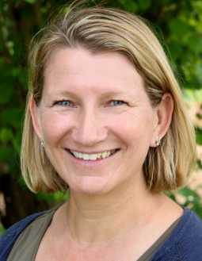
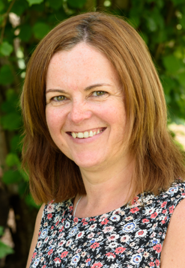

Welcome
Who is who?
Class Teacher:
Mrs L-T
Learning Support Assistants:
Mrs Cavill Miss Chapman

Slide 3
A typical day in Emperors…
8.45 – 9.20 | 9.20 – 10.20 | 10.40 – 11.00 | 11.40 – 12.00 | 13.00 – 13.15 | 13.30 – 15:00 | 15:00– 15.15
EM Worship Spelling Handwriting | English RE (Weds) | Fluency TTRS Maths.co.uk | Maths | Guided Reading ERIC Library | Foundation Subjects Topic PE (x2) French Science Computing Outdoor Leaning Music DT | Class Novel ERIC Jobs
PE Monday(indoor) and Tuesday (outdoor)

Slide 4

Core Curriculum
Reading
Writing
Maths

Slide 5
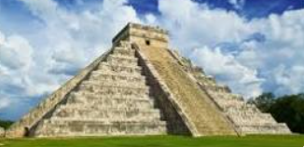
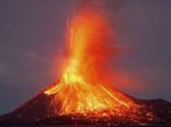
Our Curriculum
Autumn:
Ancient Maya and Natural Disasters
Design & - Food
Technology
Linked Science – Circulation

Slide 6
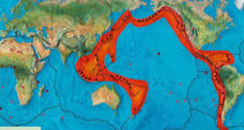
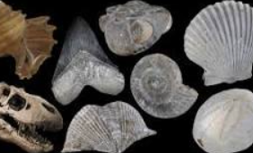
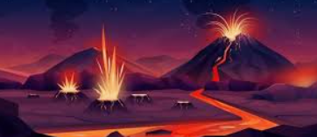
Our Curriculum
Spring:
Geography -- Pacific Ring of Fire
Science – Fossils
Geological Time
Forces
Linked Art – Volcanic Art

Slide 7
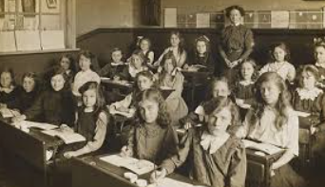
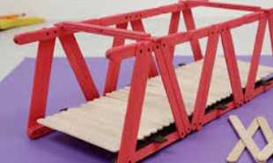
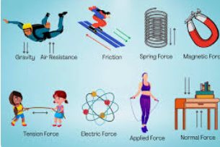
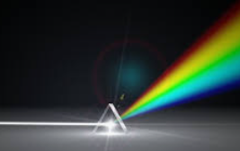
Our Curriculum
Summer
What has been the greatest
invention?
History – The Victorians
Design and Technology – Bridges
Science – Forces
Light

Slide 8
SATs
Don’t panic!
Year 6 SATs assessments take place in May. We will have a meeting for Year 6s and their parents in January
Before this, you can support your child in learning their key spellings. Practise multiplication tables for quick recall.

Slide 9
How can I support my child?
How you can help:
Encourage independence – we are starting the journey to prepare them for Secondary School!
Support them in showing resilience if they are finding something difficult
Hear them read / read to them as often as you can (4+ times a week), and ask them about what they have read – sign their reading records
Encourage them to read a wide range of books (Book Bingo can help)
Help them to learn quick recall of multiplication tables and number facts
Support them in learning spellings

Slide 10
Information
Children need:
water bottle, reading book, reading record
P.E.
Monday and Tuesday– children will get changed at school
Thursday – outdoor learning

Slide 11

Any questions?

